Slide 1
Climate & Health Advocacy Call
May 15, 2025
Claudio Lanza, Senior Policy and Advocacy Officer HEAL

Slide 2
Overview
Political and Policy Overview
Health Impacts
Focus: Heat
Key Climate Dates
EU Update
Does your country have a national Heat Health Action Plan?
What is your organisation focusing on?

Slide 3
2025/26 – Key Climate Dates
2025/26
April | 28-29 – Informal ENVI Council on climate disinformation and adaptation
May | 05-06 – EU budget – Parliament votes position + deadline public consultation
June | 17 – ENVI Council debates 2040 target + agrees on NDC submission
June | 26-27 – EUCO (might resolve contentious 2040 target standstill)
June | 30 – Member States submit Social Climate Plans
 | – Commission may publish 2040 target proposal + NDCs
 | – Commission public consultation on Climate Adaptation (Plan) ?
July | 01 – Commission publishes EU long-term budget position
July | 10-11 – Informal ENVI Council should agree on 2040 target
Fall | – Final interinstitutional agreement on 2040 target
 | – Commission Climate Adaptation Impact Assessment ?
25/26 | – Public consultations on the Climate policy package
2026 | – Publication of proposed ﻿policy package
2026 | – Commission publishes Climate Adaptation Plan

Slide 4
EU Update 1/2
Climate Adaptation Plan
New climate risk assessment from the agency
Increasing funding for regions and cities to be accelerated
New methods of increasing the resilience of cities discussed
Proposal to create European database of new technologies in Member States in the process of energy transformation, energy independence
European Climate Law – 2040 Revision
On May 5, in Parliament, Commissioner Hoekstra confirmed:
Lacking of political majority in favour of 90% reduction of domestic GHG emissions by 2040;
Exploring alternatives on how to achieve 90% target, including flexibility and conditionality mechanisms (ETS 2, international credits, sector-specific flexibility);
COM proposal on 2040 target should be submitted by Q2 2025
On May 9, Austria’s new govt declined to endorse the 90% target

Slide 5
EU Update 2/2
Post-2027 Multi Annual Financial Framework
7-year cycles (current from 2021-27, next from 2028-35)
2021-2027 budget:
EUR 1,074 trillion + EUR 750 billion NextGenerationEU
Requirement to spend 30% for climate-related objectives and 10% for biodiversity-related objectives through all programmes
Key Programs & Funding:
LIFE (€5.43 bn); Just Transition Fund (€19.32 bn); EU4Health (€4.4 bn); Horizon Europe (€93.5 bn –e.g., 35% climate-related)
Risk: Focus on new policy priorities – competitiveness, defence, security at the expense of climate, health, and environment
EP Position on climate calls for:
Across the board, support climate & biodiversity objectives; ramp up preparedness funding;
Increased directly managed support for environment and biodiversity protection and climate action building on LIFE;
Roadmap phase out all fossil fuel subsidies and env. harmful subsidies
Increased funding to cope with natural disasters;

Slide 6
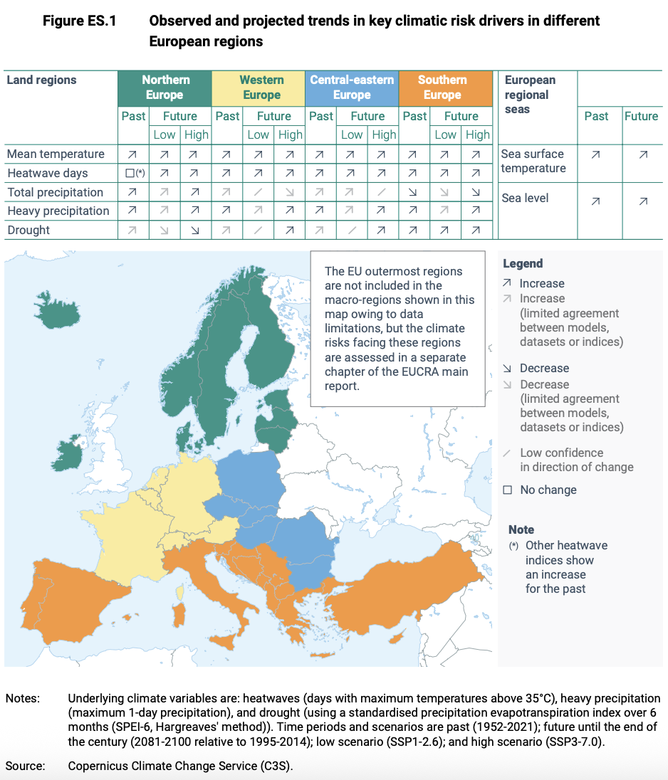
Climate Risks
Europe is the fastest-warming continent — warming at about twice the global average since the 1980s
Heat stress risks are already critical in southern Europe;
In the future, some climate risks will see an increase across European regions

Slide 7
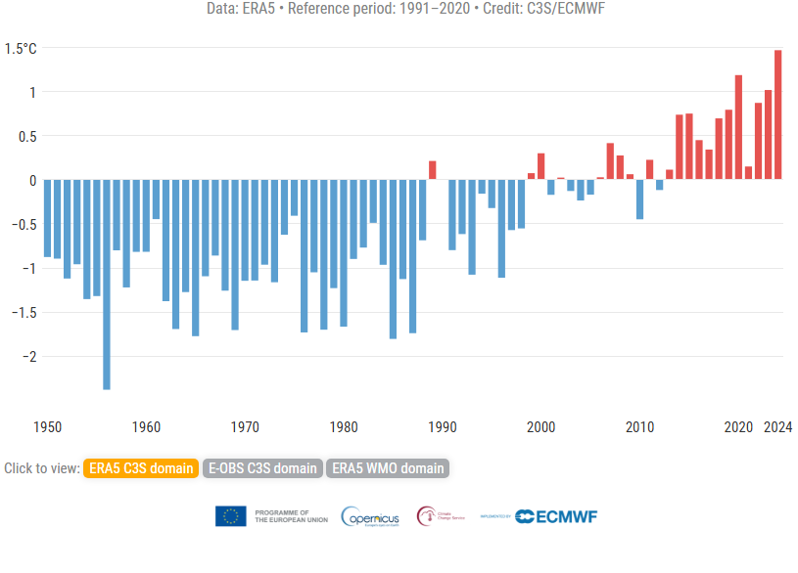
Amid Rising Temperatures...
Source: European Climate Risk Assessment

Slide 8
...EU climate effort is dwindling...
Current GHG projections indicate that EU will miss 55% reduction target in net emissions by 2030 compared to 1990 levels...
...achieving only a 49% net reduction with existing measures... (EEA, 2024)
Source: European Climate Risk Assessment

Slide 9
...while still subsidising fossil fuels
...Member States, also thanks to dedicated support from the EU budget, continue to provide environmentally harmful fossil fuel subsidies...
In 2023, EUR 136 billion to harmful subsidies...
48% of fossil fuel subsidies (EUR 53 billion) have no end date by 2030 or at all (EC, 2024)
Fossil fuel subsidies should be swiftly an immediately phased out, consistent with the ambition of limiting global warming to 1.5C.

Slide 10
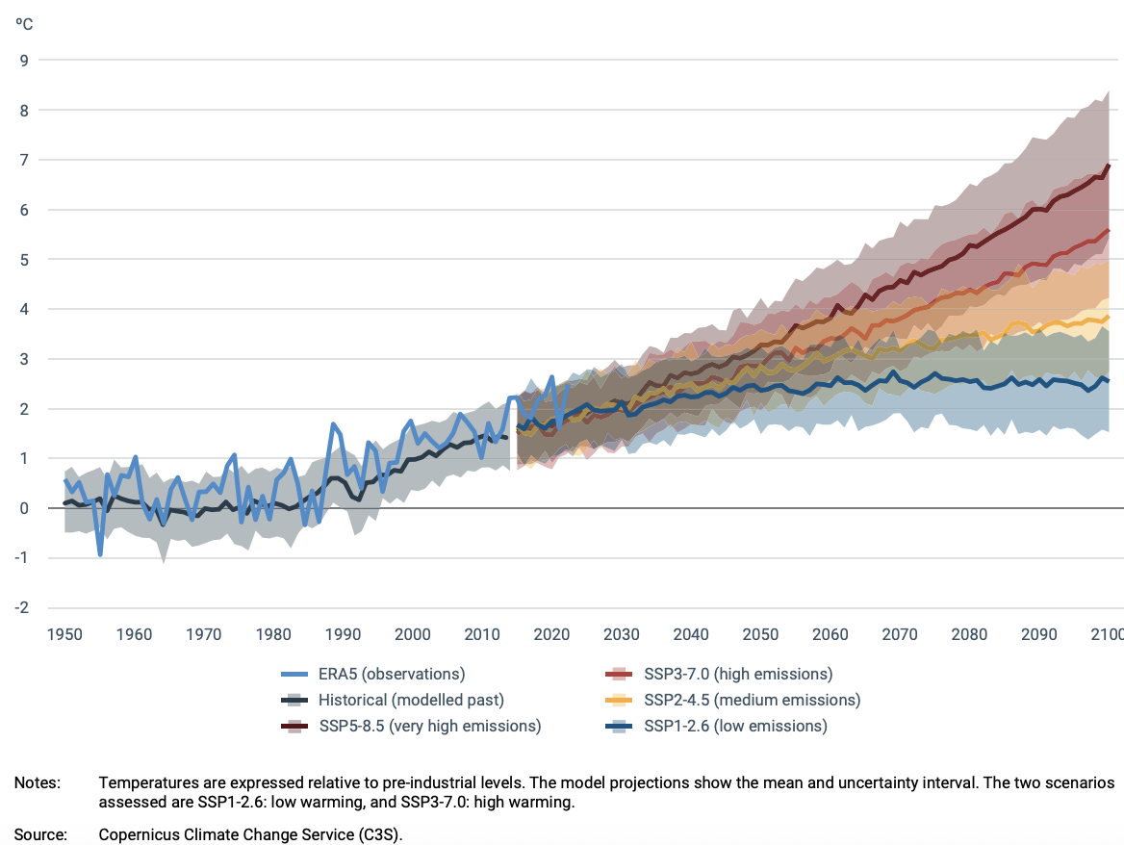
Climate ambition should step up
Figure: Observed and projected temperature increase over European land area
The EU’s scientific advisory council has called for a 2040 target of at least 90%.
The EU should aim to achieve climate neutrality, a 100% target, by 2040.

Slide 11
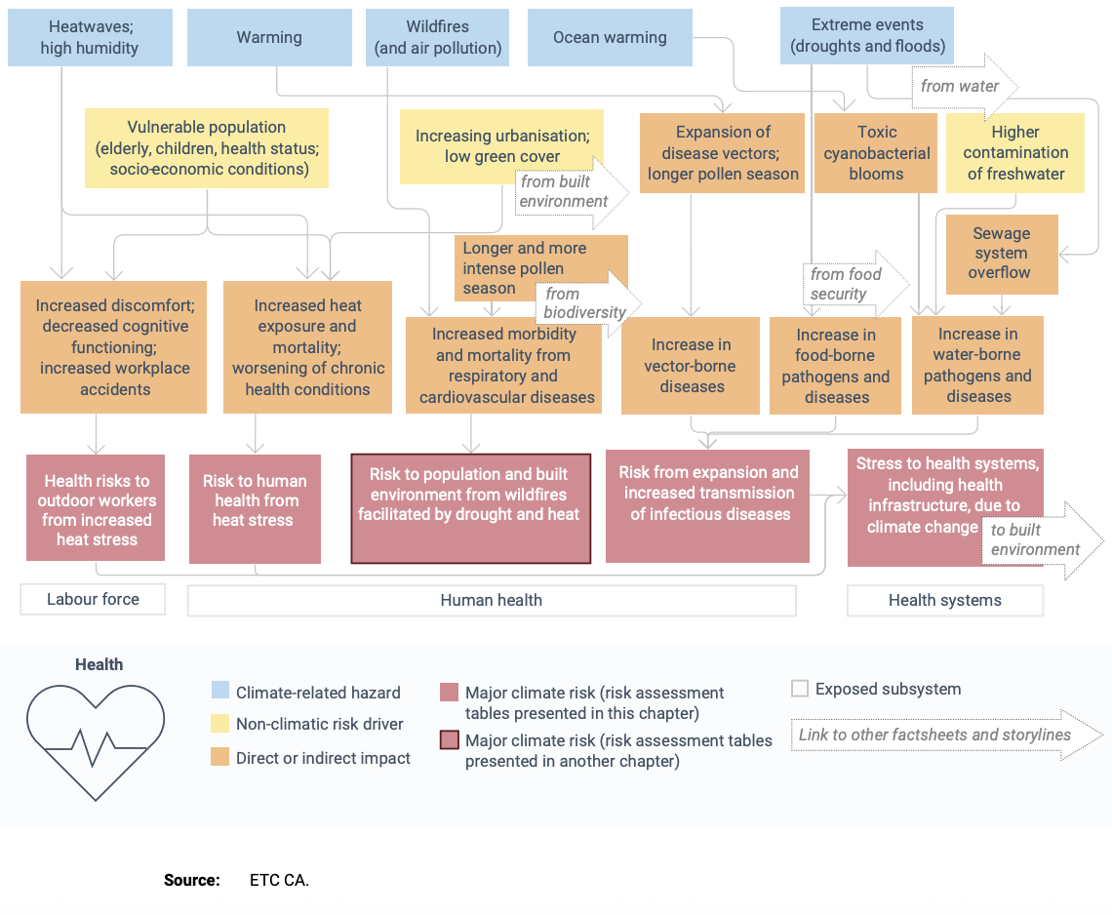
Climate-related Health Impacts
Subsystems
heat stress, air pollution and airborne allergens
Vector-borne diseases
Water and foodborne diseases
Labour force impacts

Slide 12
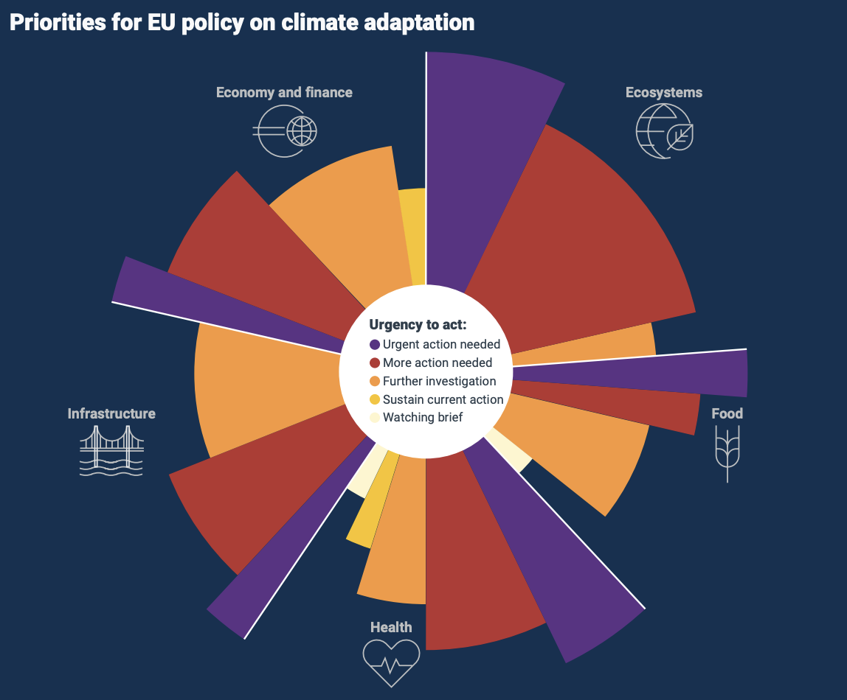
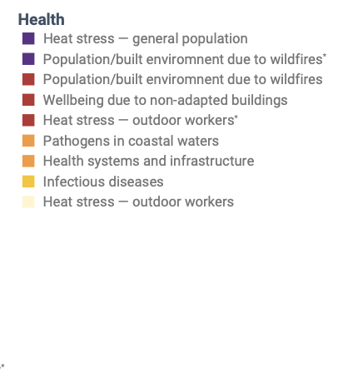
Urgency to Act on Health Risks

Slide 13
Heat – Largest & Most Urgent Hazard
Urgent need to address heat stress through Heat Health Action Plans, considering strong role for EU and Member States

Slide 14
Presence of HHAPs in Europe

Slide 15
Thank you
Claudio Lanza
Senior Policy and Advocacy Officer
claudio@env-health.org
MUNDO MADOU
Avenue des Arts 7/8, B-1210 Bruxelles
www.env-health.org
HEAL gratefully acknowledges the financial support of the European Union (EU) for the production of this publication. The responsibility for the content lies with the authors and the views expressed in this publication do not necessarily reflect the views of the EU institutions and funders. The European Climate, Infrastructure and Environment Executive Agency (CINEA) and the funders are not responsible for any use that may be made of the information contained in this publication.
HEAL EU transparency register number: 00723343929-96

